Slide 1
Trout Foods
(and How to Imitate Them)
Presented by Dan Robertson
December 12, 2019

Slide 2
What Trout Eat
Mayflies
Stoneflies
Caddisflies
Midges
Other Aquatic Insects (Bred in Water):
  Craneflies
  Water Boatman
  Dobsonflies
  Alderflies
  Damselflies
  Dragonflies

Slide 3
What Trout Eat (continued)
Terrestrial Insects (Not Bred in Water):
  Ants
  Beetles
  Grasshoppers
  Crickets
  Cicadas
  Spruce Budworms
  Leafhoppers
  Inchworms

Slide 4
What Trout Eat (continued)
Crustaceans (live in water):
  Scuds
  Sowbugs
  Mysis Shrimp
  Crayfish
Other Trout Foods:
  Leeches
  Worms
  Minnows/Baitfish
  Sculpins
  Small Frogs
  Mice

Slide 5
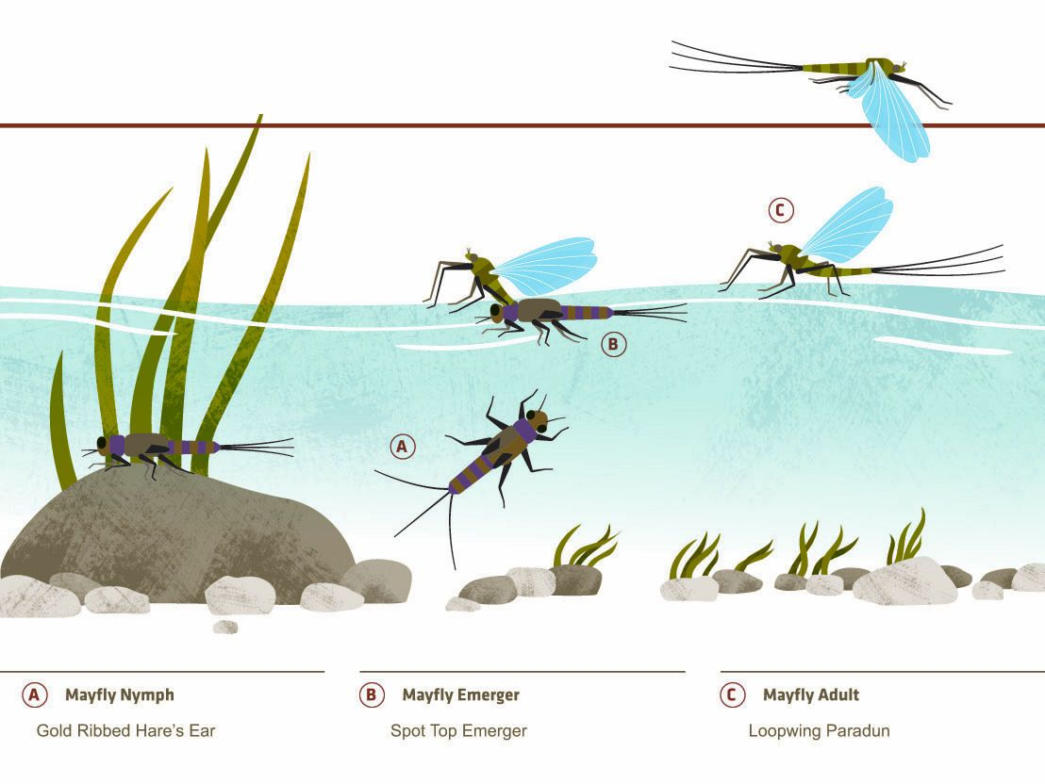
Life Cycle of the May Fly

Slide 6
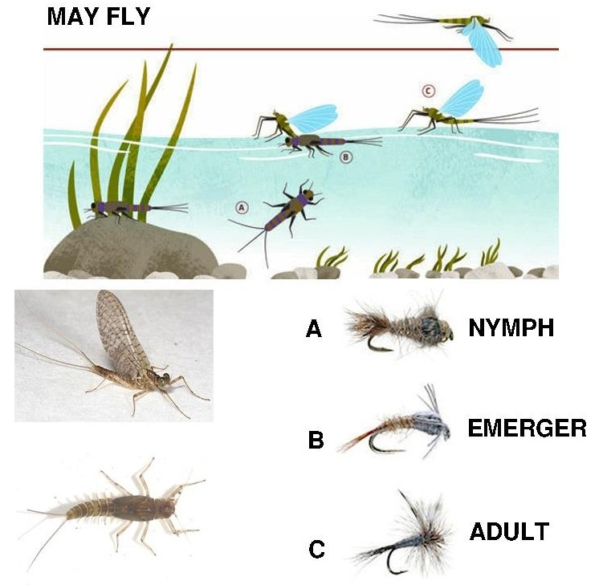
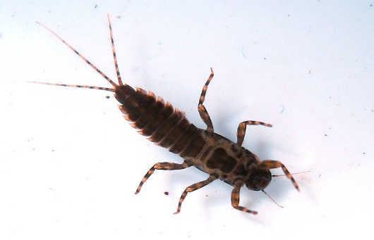
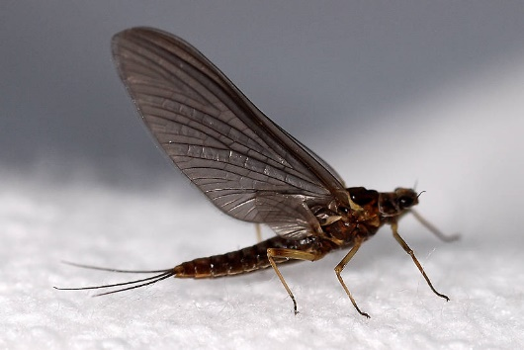
Life Cycle of the Mayfly
(Gold Ribbed Hare’s Ear)
(Spot Top Emerger)
(Looped Wing Paradun)

Slide 7
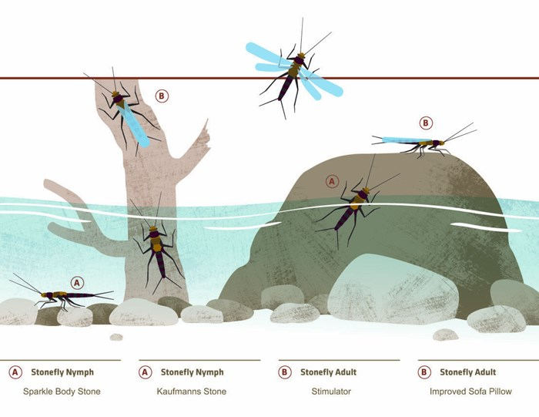
Life Cycle of a Stone Fly

Slide 8
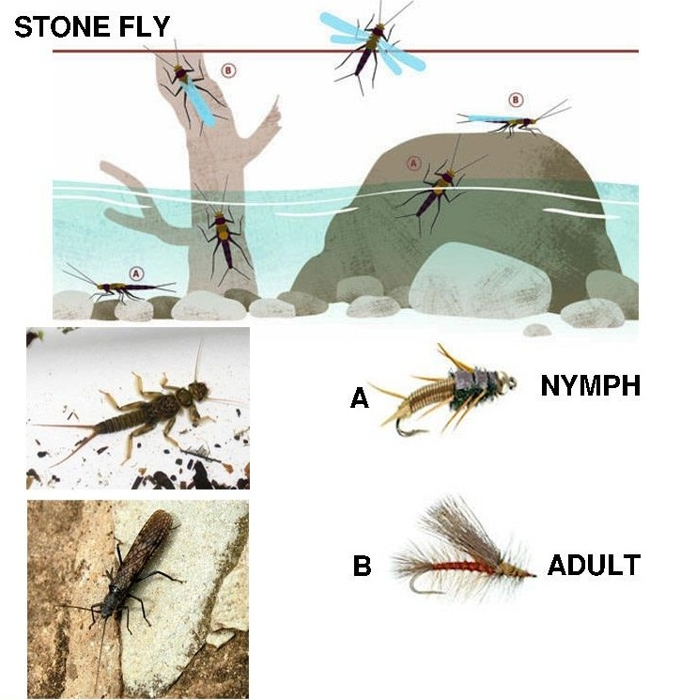
Life Cycle of the Stone Fly
(Kaufmanns Stone)
(Stimulator)

Slide 9
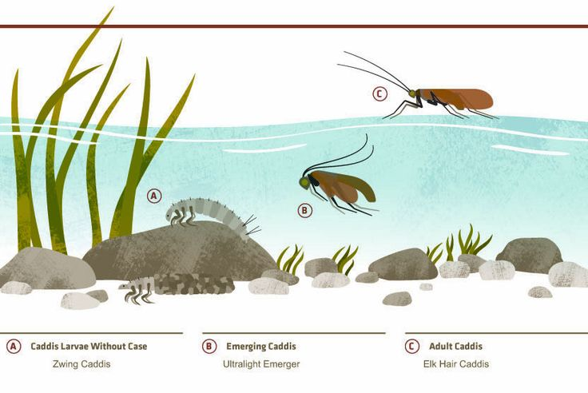
Life Cycle of the Caddis Fly

Slide 10
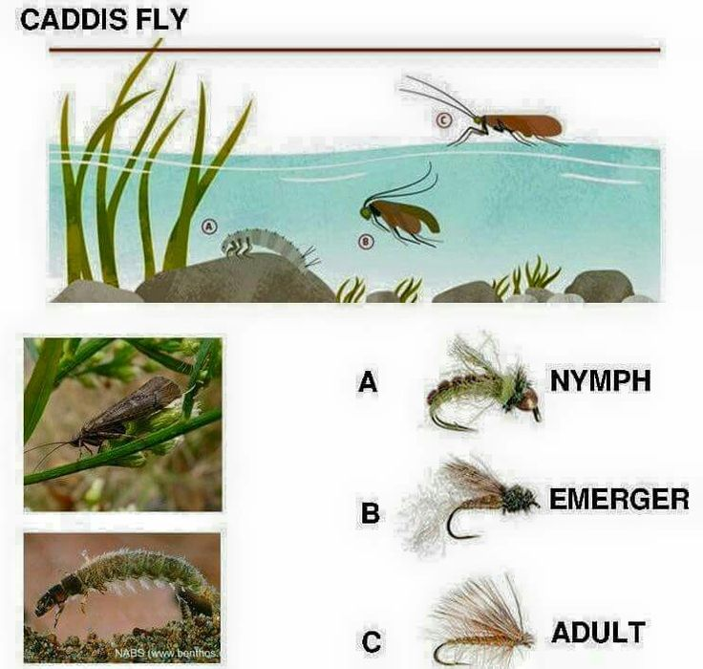
Life Cycle of the Caddis Fly
(Zwing Caddis)
(Ultralight Emerger)
(Elk Wing Caddis)

Slide 11
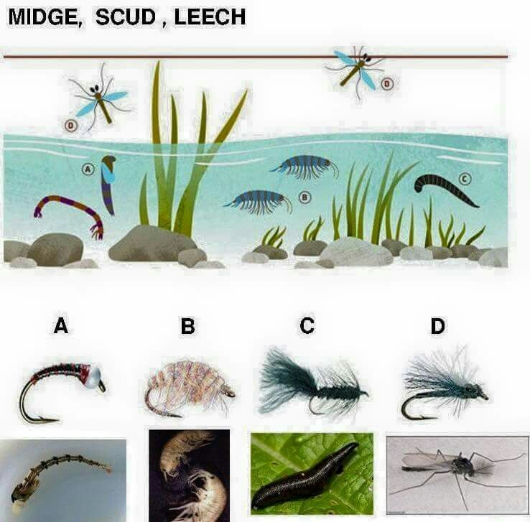
Other Sub-Surface Sources of Food

Slide 12
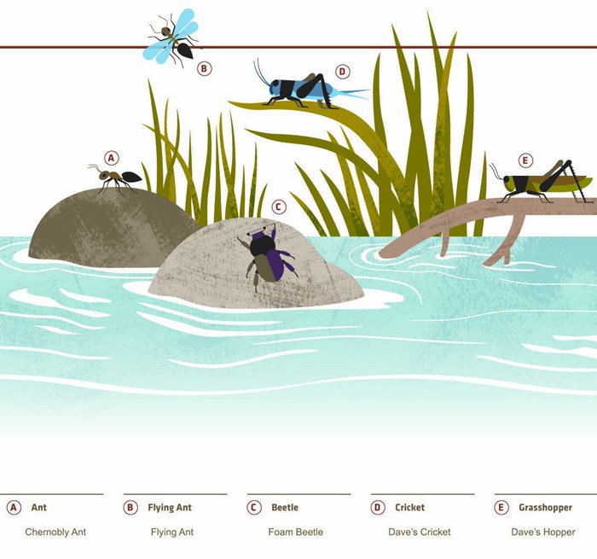
Streamside Terrestrials

Slide 13
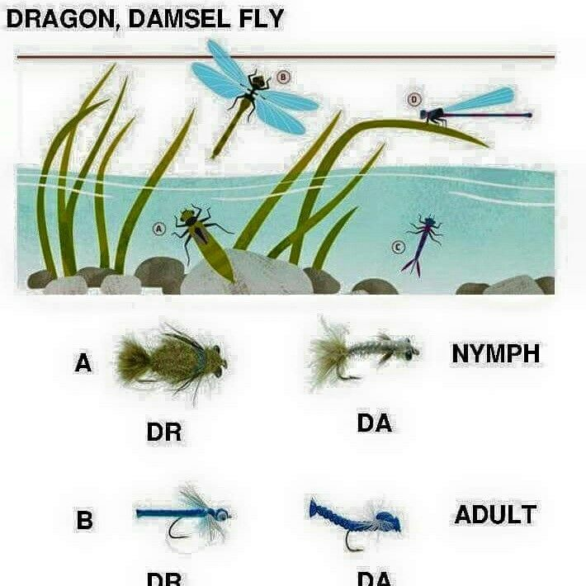
Other Flies
DR
DA

Slide 14
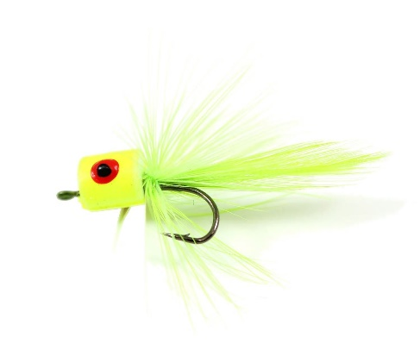
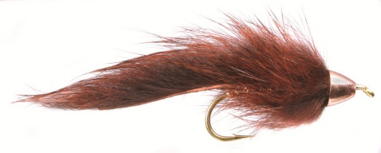
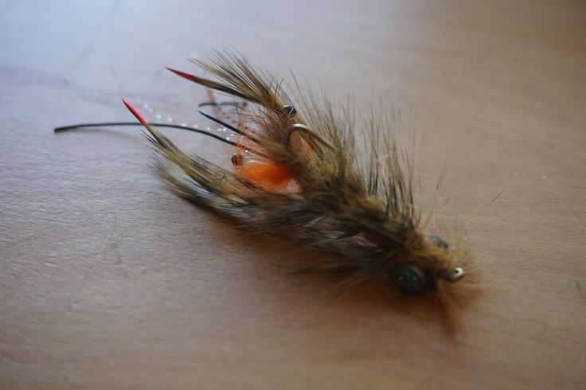
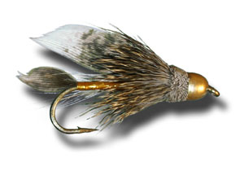
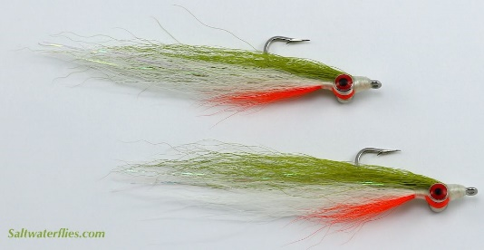
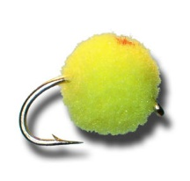
Minnows, Crayfish, Frogs, Eggs
Barr’s Slump Buster
Popper
Crayfish Pattern
Muddler Minnow
Glo Bug – Egg Pattern
Clouser Minnow

Slide 15
Trout Eating Habits by Season
Months December – March March - April May – June (May – August in cooler western and far northern rivers) | Foods Most Likely Eaten Midge larvae, minnows, stonefly nymphs, leeches, Crustaceans such as sowbugs or scuds. Mayfly nymphs and adults, stonefly nymphs, minnows, crustaceans, and midge larva and midge adults. Mostly larger emerging and adult mayflies caddisflies, and stoneflies. Minnows and crustaceans will also be taken. | Typical Daytime Water Temperature 35 – 40 degrees 40 – 50 degrees 55 – 70 degrees | Trout Feeding Behavior Very little movement, which is mostly in bottom of slow pools. Fish will not chase their prey more than a few inches. Trout will become slightly more active at the upper end of this temperature range and may feed on the surface in the middle of the day. Trout are active all day long. Fish will chase insect larvae and make splashing rises. Trout will also drift feed below the surface and sip mating insects that have fallen onto the water surface.

Slide 16
Trout Eating Habit by Season (continued)
Months July - August September – November | Foods Most Likely to be Eaten Ants, beetles, grasshoppers, and other terrestrial insects become much more important as aquatic insects dwindle. Mayflies, caddisflies, and stoneflies are mostly tiny—smaller than size 16. Large fish will prowl for crayfish and minnows after dark. Both tiny and large mayflies, caddisflies, and stoneflies. Minnows are eaten by large fish on spawning migrations. Midges and crustaceans once again become important, as hatches of aquatic insects become even more sparse. | Typical Daytime Water Temperature 55 – 75 degrees 50 – 60 degrees | Trout Feeding Behavior Feeding is concentrated in early morning late evening, and after dark. Most feeding is more sedate, rises will be more of the quiet sipping variety. Feeding is erratic—it can be very active one day and almost dormant the next, depending on weather and geography. Best hatches and fishing are in the middle of the day.

Slide 17
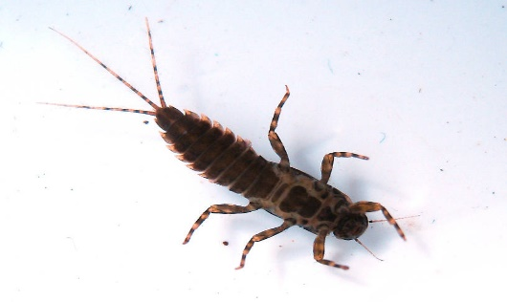
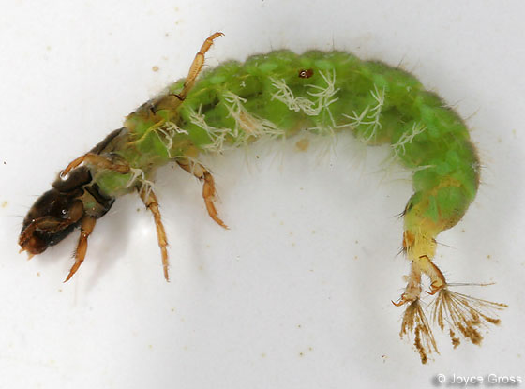
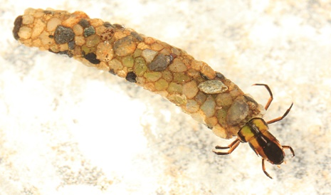
Important Orders of Aquatic Insect Larvae
Insect | General Appearance | Tails | Body
Mayfly Nymph | Size 1/8 to 1 ½ inches long. Color: tan, brown, cream, or olive. Shape: Anything from very skinny to broad and flatten | Thin and as long as the body of the insect. Two or three are present | Feathery gills on abdomen may be apparent or almost invisible. Never has gills under thorax. Distinct wing pad on top of thorax.
Caddis Larva | Size ¼ to 2 inches long. Color: Dull shade of cream, brown, olive, tan, yellow, or bright green. Shape: Caterpillar-like. Found in all types of water. Most larvae form cases made from stones, sticks, or other vegetation. | None. A pair of tiny hooks are present instead of tails. | Abdomen is very fleshy and without gills. No wing pads present. Free-living caddisflies (ones that do not build cases) can be easily confused with aquatic beetle larva, but examination with a hand lens shows that beetle larvae have distinct pincers around the mouth.

Slide 18
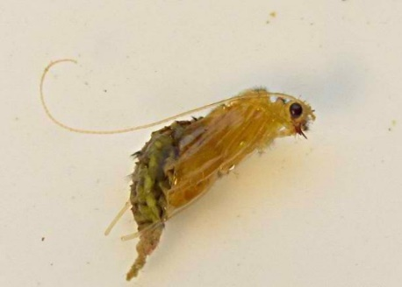
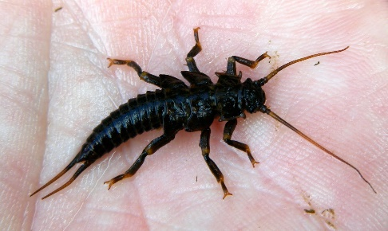
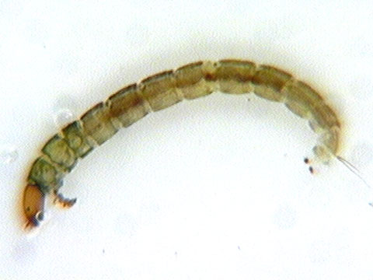
Important Orders of Aquatic Insect Larvae
Insect | General Appearance | Tails | Body
Caddis Pupa | Size ¼ to 1 ¼ inches long. Color: dull Shape: distinctly curved. Found drifting in all types of water. | None. | Long trailing antennae. Emerging wings apparent and held close to body
Stonefly Nymph | Size ½ to 2 ¼ inches long. Color: brown, black, tan, or yellow. Shape: Mostly flattened. Nearly always found in fast water. | Always two, shorter than body length. | Gills located under thorax. Distinct antennae and wing pads. Legs robust, each leg ends in two claws.
Midge Larva | Size 1/32 to 3/8 inches long Color: tan, brown, black, bright green, or red. Shape: Resembles tiny maggots. Found in slow water. | None, but a pair of tiny vestigial legs is visible at end of abdomen. | Eyes tiny. One pair of small prolegs at head.

Slide 19
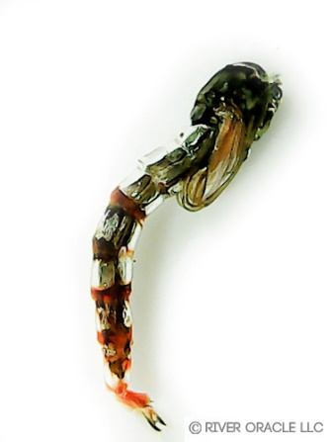

Important Orders of Aquatic Insect Larvae
Insect | General Appearance | Tails | Body
Midge Pupa | Size 1/32 to 3/8 inches long. Color: Dull Shape: Curved with distinctly segmented abdomen. Found in slow water. | None, but small feathery gills can be seen at the end of the abdomen | Wing pads tucked close to body. Distinct feathery gills branching off the front of the head. No long trailing antennae,
Insect | Appearance at Rest | Appearance in the Air | Behavior
Mayfly Dun | Resembles a tiny sailboat. Wings always erect. Wings are speckled or translucent. Body is full and opaque. Color: Varies from dark brown to bright pink. | Looks like tiny butterflies. Usually a distinct cross-shaped profile. Only one pair of wings apparent. | Flutter or remain at rest on water. Stately, slow fliers. Usually fly upstream.

Slide 20
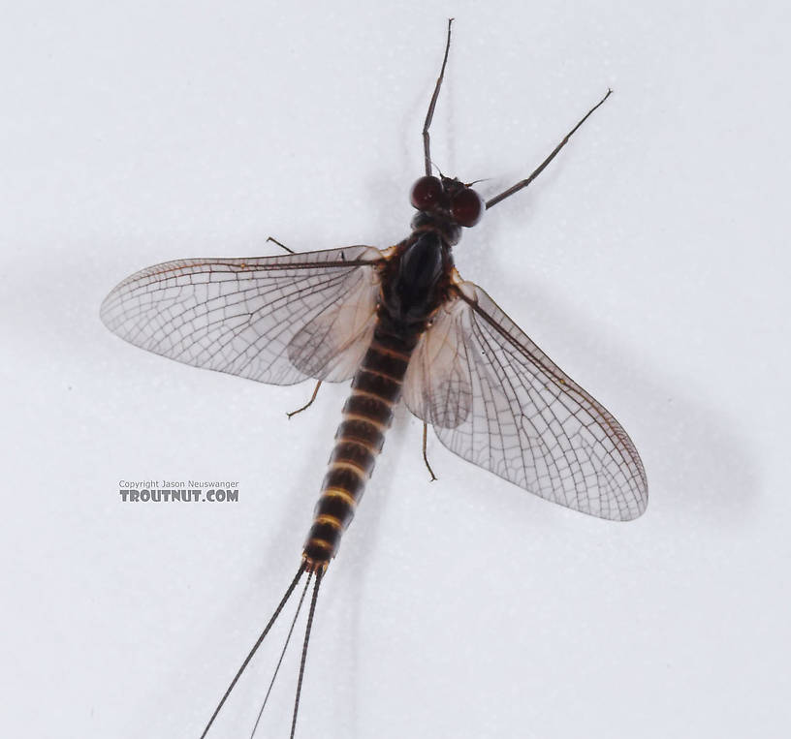
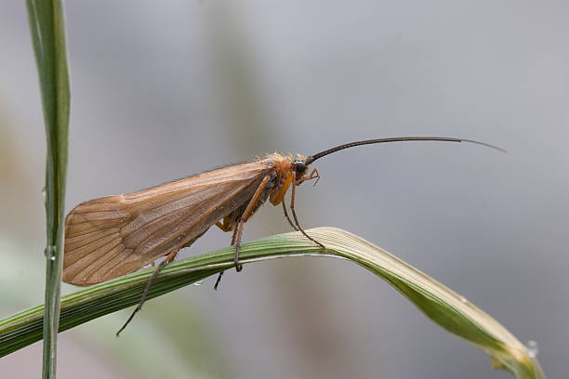
Important Orders of Aquatic Insect Larvae
Insect | Appearance at Rest | Appearance in the Air | Behavior
Mayfly Spinner | Wings may be erect or prone on the surface of the water(in spent adults). Wings always transparent, sometime with speckles. Bodies very skinny. Difficult to see on water when spent without close observation of the surface. Colors: Similar to those of duns. | Tails distinct and longer than those of duns. Females can be seen with egg sacks. Only one pair of wings apparent. | Fast agile fliers. Often seen in large mating swarms above the surface of the water. Will also form mating swarms over wet roads and shiny cars. Will be seen dipping and hovering over water. Emerged adults usually fly upstream.
Caddis Adult | Wings are tent-shaped and held low over body. Long distinct antennae. No tail. Colors: Generally dull tan, brown, black, or gray. | Looks like a small moth when they fly. Only one pair of wings apparent. | Very active when hatching. Emerging adults often flutter and skitter across the water when hatching; they usually do not rest on water afterward. Quick fliers once they hatch. Usually fly upstream. Mating swarms fly upstream in long, continuous columns.

Slide 21
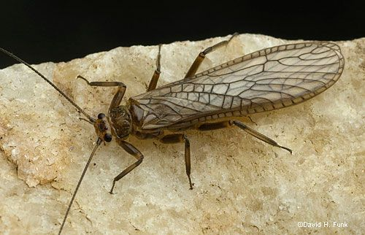
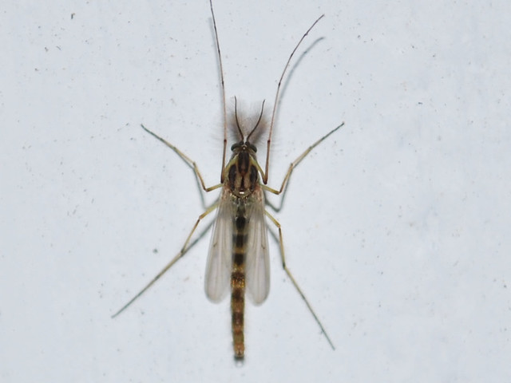
Important Orders of Aquatic Insect Larvae
Insect | Appearance at Rest | Appearance in the Air | Behavior
Stonefly Adult | Wings always held flat over body. Adults look nymphs with wings. Most hatch on rocks at the edge of streams unlike other aquatic insects. | Two pairs of apparent wings. Heavy body usually seen hanging below wings in flight. | Slow, clumsy fliers. Will fly up or downstream. Only seen on the water when blown onto the surface after hatching or when returning to the water for mating flights. Females can be seen dipping into the water during mating flights.
Midge Adult | Resembles small mosquitoes. Long, spindly legs and feathery antennae. Distinct soft, fuzzy look. Wings held tight to body when at rest. Color: Usually black, gray, or cream. | Look like gnats or mosquitoes in the air. | Often skitter across the surface when hatching. Quick and agile fliers. Mating swarms form large groups just above the surface of the water. Individual adults often clump together in twos and threes.

Slide 22
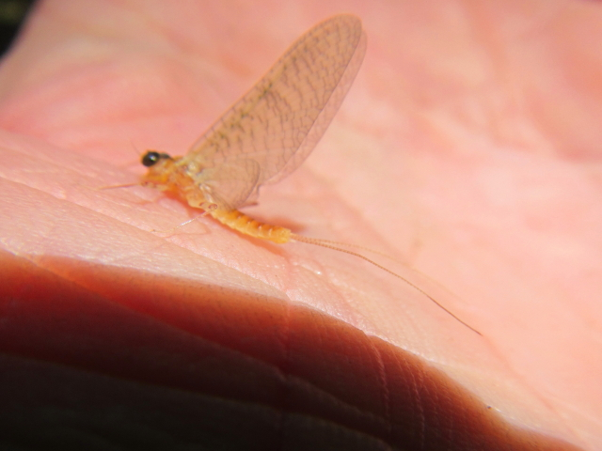
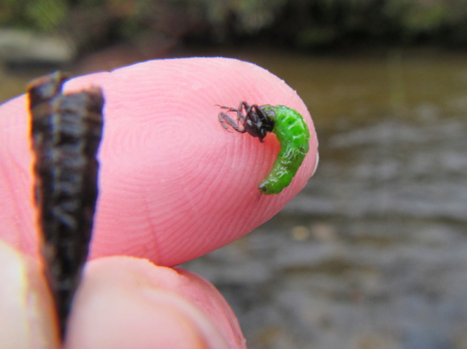
How to Determine What is Hatching
Observation, Seining
Examine Bottom of Rocks
Ask Fellow Anglers
Ask a Fly Shop
Review a Hatch Chart
Mayfly
Sulphur
Caddis Larva

Slide 23
Suggested Mayfly Nymph Patterns
Patterns | Sizes | Region and Season
Pheasant Tail | 12, 14, 16 ,18 ,20 | All regions, all seasons
Gold Ribbed Hare’s Ears | 8, 10, 12, 14, 16, 18 | April – October in all regions
Zug Bug | 10, 12, 14 | June – September in all regions
Prince Nymph | 12, 14, 16, 18 | May – June in the East
Copper John | 14, 16, 18, 20, 22 | April – June in the East
Eastern March Brown | 10, 12, 14 | May – June in the East
Hendrickson | 12, 14, 16 | May in the East
Callibaetis | 12, 14, 16 | West, mainly in lakes and spring creeks
Lepage’s Bead-head Mayfly | 12, 14, 16 | May – June in all regions

Slide 24
Suggested Mayfly Dries and Emerger Patterns
Pattern | Sizes | Region and Seasons
Blue Winged Olive | 18, 20, 22 | All of North America, all season long, especially in Mar., Apr., Oct.
Hendrickson | 12, 14, 16 | April – May in the East.
Pale Morning Dun | 14, 16, 18, 20 | May – August in the West.
Pale Evening Dun | 14, 16, 18, 20 | May – June in the East.
Gray Fox | 10, 12, 14, 16 | May – June in the East.
Callibaetis | 12, 14, 16 | June – August in the West.
Western Green Drake | 12, 14, 16 | June – July in the West.
Coffin fly | 10 ,12 | May – June in the East.
Dun Variant | 10, 12, 14 | June – September in all regions
Rusty Spinner | 12, 14, 16, 18, 20 | April – August in all regions
Trico Spinner | 18, 20, 22, 24 | August – September in all regions
Olive Spinner | 12, 14, 16 | June – July in all regions
Adams | 10, 12, 14, 16, 18 ,20 | May – October in all regions

Slide 25
Suggested Caddis Nymph and Wets Patterns
Pattern | Size | Region and Seasona
Hare’s Ear Nymph | 12, 14, 16, 18 | All Regions, April - October
Bead-Head Caddis | 14, 16 | All Regions, April – October. Pupa in green, tan, and gray.
LaFontaine Deep | 14, 16 | All Regions, April – October. Pupa in olive, and tan
Green and Tan Caddis Larva | 12, 14, 16 | All Regions, April - October.
Hare’s Ear Wet Fly | 12, 14, 16 | All Regions, April - October
Partridge and Orange Soft Hackle | 12, 14, 16 | All Regions, April - October

Slide 26
Suggested Caddis Dry Patterns
Pattern | Size | Region and Season
X-Caddis in tan, green, and black | 12, 14, 16, 18 | All Regions, April - October
Elk Hare Caddis in tan, olive, and black | 12, 14, 16, 18 | All Regions, May - October
Henryville Special | 12, 14, 16 | All Regions, May - June
Spent Caddis in tan, green, gray, and black | 12, 14, 16, 18 | All Regions, May - October

Slide 27
Suggested Stonefly Nymph Patterns
Pattern | Size | Region and Season
Kaufmann’s Black Stone | 2, 4, 6, 8, 10 | West Coast and Rocky Mountains, May - July
Golden Stone | 6, 8, 10, 12 | All Regions, May – July
Hare’s Ear Nymph | 8, 10, 12, 14 | All Regions, May - July
Little Yellow Stone | 14, 16, 18 | All Regions, June - August

Slide 28
Suggested Stonefly Dries Patterns
Pattern | Size | Region and Season
Orange Stimulator | 2, 4, 6, 8 | West only, June - July
Improved Sofa Pillow | 2, 4, 6, 8 | West only, June - July
Henry’s Fork Salmonfly | 2, 4, 6, 8 | West only, June - July
Yellow Stimulator | 6, 8, 10, 12, 14, 16, 18 | All Regions, June - August

Slide 29
Suggested Midge Nymph Patterns
Pattern | Size | Region and Season
Red Midge Lava | 14, 16, 18, 20, 22 | West Coast and Rocky Mountains; Eastern spring creeks. Ponds and lakes throughout trout range. All year.
Green Midge Lava | 18, 20, 22 | West Coast and Rocky Mountains; Eastern spring creeks. Ponds and lakes throughout trout range. All year.
Brassie | 18, 20, 22, 24 | All Regions, most useful November – April, but year-round in spring creeks and tailwaters.
Disco Midge | 18, 20, 22, 24 | All Regions, most useful November – April, but year-round in spring creeks and tailwaters.

Slide 30
Suggested Midge Dries Patterns
Pattern | Size | Region and Season
Griffith Gnat | 14, 16, 18, 20, 22, 24 | All regions; most useful November – April, but year-round in spring creeks and tailwaters.
Palomino Midge | 18, 20, 22 | All regions; most useful November – April, but year-round in spring creeks and tailwaters.

